Slide 1
Environmental Impact Analysis
Members:
Manaswi Patil
Archi Jadhav
Prachal Desai
Shrenik Dubal

Slide 2


Environmental ImpEnvironmental Impact Analysis (EIA)
EIA is a process that evaluates the potential environmental effects of a proposed project, aiming to ensure sustainable development by integrating environmental considerations into planning and decision- making.er BI
This project analyzes the environmental impact of various human activities, leveraging the power of Power BI to create insightful visualizations and dashboards. We aim to shed light on pressing environmental issues, facilitating informed decision-making for a sustainable future.

Slide 3
Literature Survey
1
Environmental Impact Assessment
Reviewed existing research on environmental impact assessment methodologies, focusing on key indicators and data collection techniques.
Sustainability Metrics
Examined widely accepted sustainability metrics, such as carbon footprint, water usage, and biodiversity impact, to inform our analysis.
2
Power BI Applications
Explored the use of Power BI in environmental data analysis, highlighting its capabilities in visualization, data manipulation, and reporting.
3
4
Case Studies
Studied relevant case studies where Power BI was used to analyze environmental impacts, extracting best practices and potential challenges.

Slide 4
PROBLEM STATEMENT:
How can we effectively analyze and interpret data on pollutant emissions from industrial activities to assess their impact on local air quality and public health? What data metrics are most crucial for this analysis?
Data is Scattered Hard to Understand Hard to Make Decisions
Environmental information is spread out in different places, making it hard to get a full picture.
The way this data is usually shown makes it difficult for people to really understand the issues.
Without clear information, it's challenging for people to make choices that are good for the environment.

Slide 5

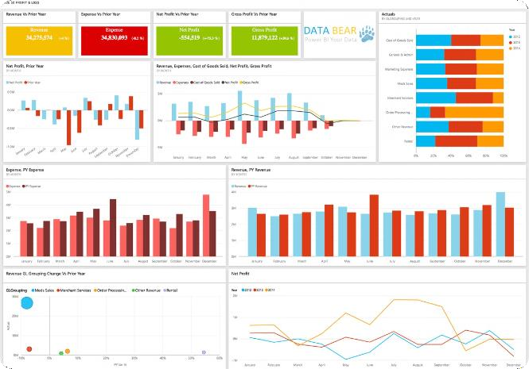
Proposed System (Features)
1
Data Acquisition
Gathering environmental data from various sources, including government
agencies, industry reports, and scientific databases.
2
Data Cleaning and Transformation
Cleaning and transforming raw data to ensure accuracy and consistency, preparing it for analysis and visualization.
3
Power BI Dashboard Development
Creating interactive and visually appealing dashboards using Power BI to present key environmental indicators, trends, and insights.
4
Data Visualization
Utilizing various chart types, maps, and other visual elements to effectively communicate complex environmental data and insights.

Slide 6


Power BI Dashboard Design
Dashboard Title | Environmental Impact Analysis
Key Metrics | Carbon emissions, water usage, biodiversity impact, air quality, waste generation.
Visualizations | Interactive maps, line charts, bar graphs, scatter plots, and pie charts.
Filters and Slicers | Allowing users to explore
 | data by region, industry,
 | time period, and other
 | relevant factors.

Slide 7

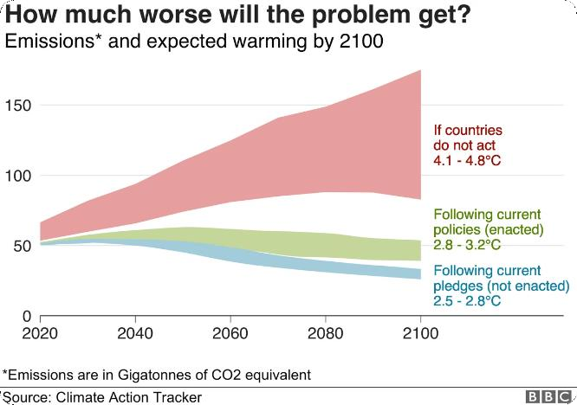




Insights and Recommendations
Based on the analyzed data, we can generate actionable insights and recommendations for stakeholders to improve environmental performance and drive sustainable practices.
Identify Key Impact Areas
Pinpoint specific activities or industries with significant environmental impacts, allowing for targeted interventions.
Track Progress Over Time
Monitor environmental performance over time, highlighting positive trends and identifying areas requiring further improvement.
Set Realistic Goals
Develop measurable and achievable goals based on data-driven insights, promoting continuous improvement and accountability.
Engage Stakeholders
Communicate key findings to stakeholders, fostering collaboration and promoting informed decision-making for environmental sustainability.

